Slide 1
UX Summit 2023
Designing metaphors, designing collaboration
Alex Bielen and Laura Nash

Slide 2
1/ Metaphors matter

Slide 3
Humans are batteries.

Slide 4
P1: “I’m drained and I hope to recharge this weekend!”
P2: “Ugh… me too. I’m trying a new recipe – learning something new energizes me.”

Slide 5
Time is money.

Slide 6
P1: “So, how did you spend your weekend?”
P2: “Well, I invested my time in learning how to make pasta by hand.”
P1: “By hand!? You can buy pasta at the store! You should budget your time better.”

Slide 7
Argument is war.

Slide 8
P2: “Your position is indefensible! Homemade pasta is delicious!”
P1: “I could easily attack the weak points in that argument!”
P2: “Okay, try to shoot it down!”

Slide 9
So, what are these metaphors doing?

Slide 10
One thing metaphors do is conceptual translation. They express hard-to-understand ideas in easy-to-understand ways.

Slide 11
In other words,
metaphor is a plain language tool.
Government and tech are complicated fields — plus, everyone has discipline-specific vocabulary and mental models.

Slide 12
In other words,
metaphor is a plain language tool.
Metaphors help us share specialized concepts and context with teammates and partners — simply. They move ideas from one brain to another.

Slide 13
Common metaphors also
reflect a particular culture’s values and preoccupations.

Slide 14
The metaphors we’ve discussed so far
humans are batteries
time is money
argument is war
are not universal across cultures and languages.

Slide 15
If we listen for common metaphors at work, we will hear unspoken values reflected back. These won’t always match our ideals.
We can design metaphors that work better —
for our team, and for the values we want to embody. And that matters because…
Notes:
We’ll get into this later on as we talk more about designing metaphors.

Slide 16
Metaphors can structure the actions we take and influence our reasoning.

Slide 17
If we use racist, sexist, ableist, or otherwise exclusionary metaphors, they can structure our solutions in exclusionary ways.
But even “neutral” metaphors aren’t neutral…

Slide 18

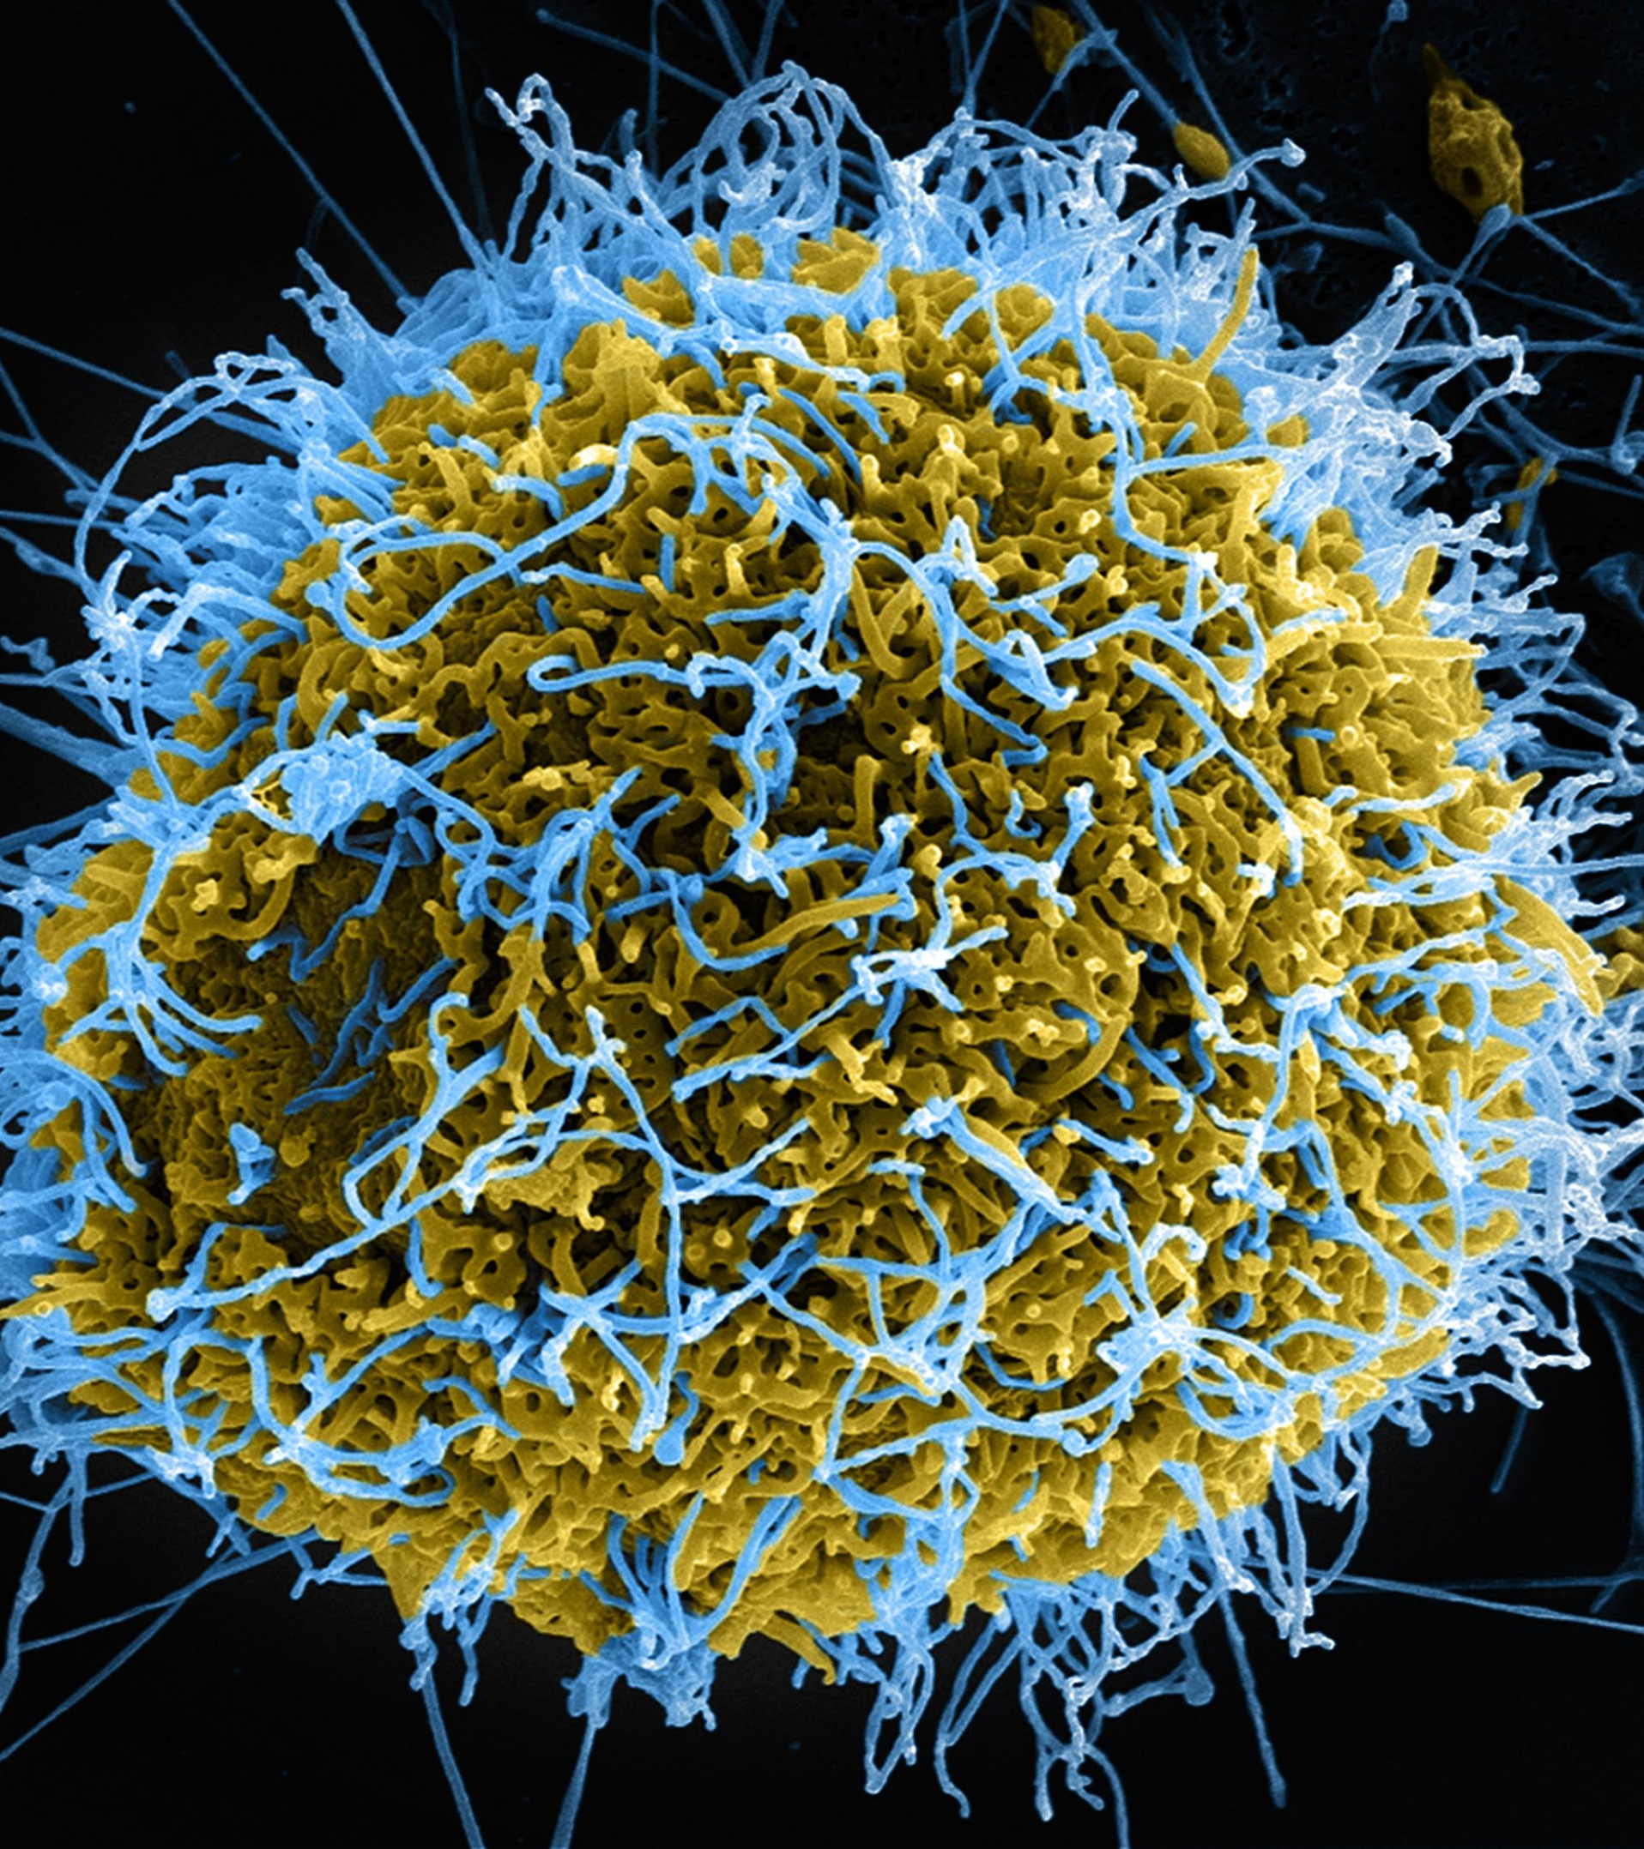
Crime as beast versus crime as virus
Notes:
This idea was empirically verified by Thibodeau and Boroditsky in a paper called “Metaphors we think with”.
In their study, participants received a report on increasing crime rates in a city.
Participants were split into two groups: One group saw a version of the report in which crime was referred to as a "beast," and the other group as a "virus."
Results showed metaphors influenced proposed solutions.
The "Beast" group recommended catching criminals, tougher laws.
The "Virus" group suggested investigating root causes, social reform.
-------
Tiger image source: Microsoft PowerPoint stock image
Virus image source:
NAID (National Institute of Allergy and Infectious Diseases, part of NIH)
https://www.flickr.com/photos/54591706@N02/14440817981/

Slide 19
Metaphors shape our thinking.
So what happens when we use different metaphors for an organization?

Slide 20
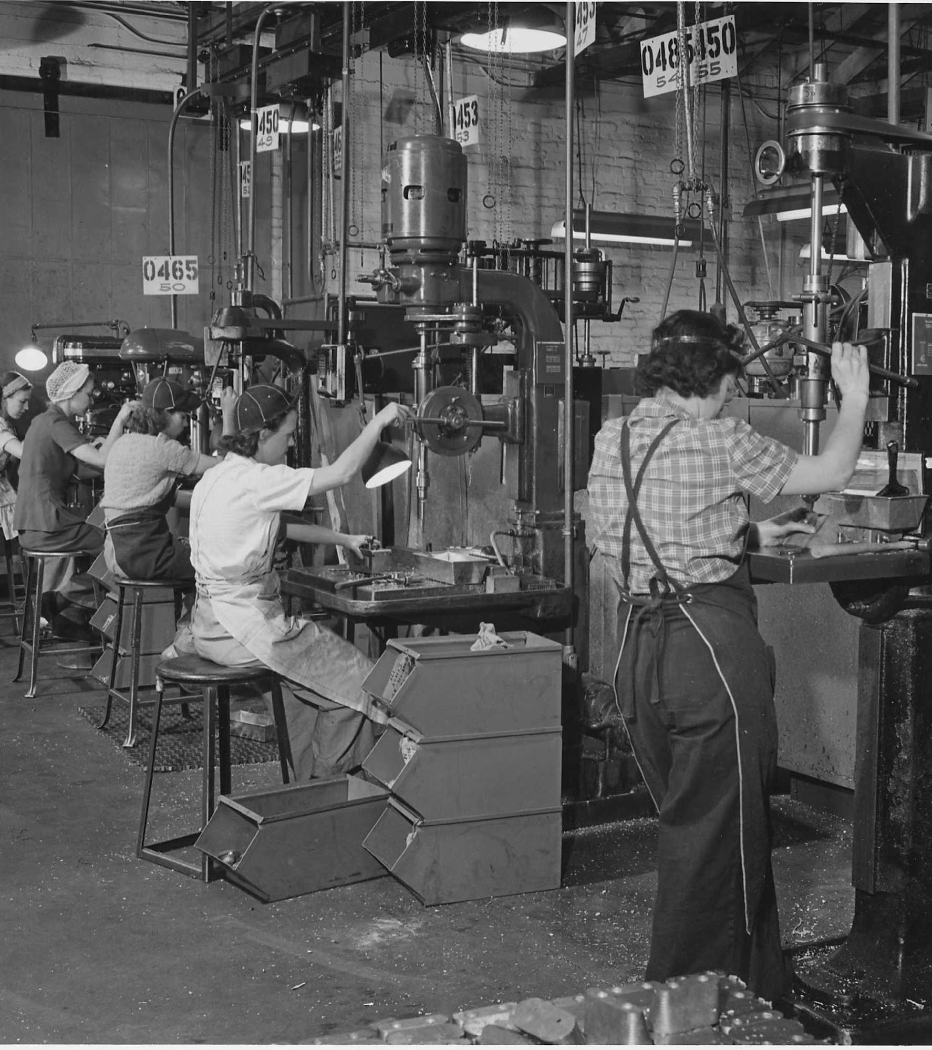
Organization as a
machine
Values control, logic, and the ability to “replace parts.”
Works in a stable environment, with repeatable outcomes
Fails when the environment changes, or employees want more agency
Notes:
Image source:
US National Archives (No known copyright restrictions)
https://www.flickr.com/photos/35740357@N03/5531929237/

Slide 21
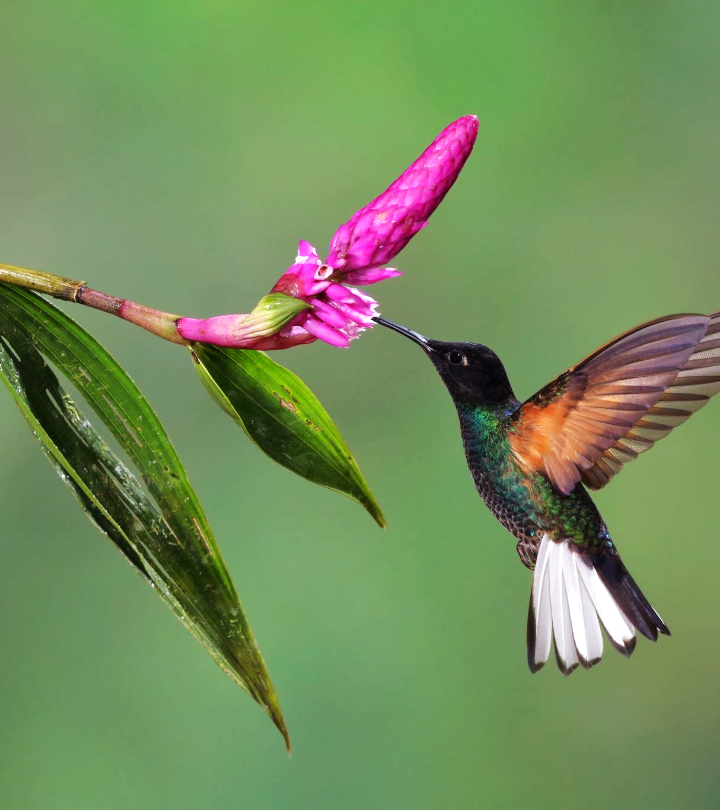
Organization as an organism
Values fitting into the larger environment surrounding the organization.
Works when outside change affects the organization’s survival
Fails when change is continuous and there’s too much uncertainty
Notes:
Image source: Microsoft Powerpoint stock image

Slide 22
These are not necessarily exclusive! You can try many different metaphorical lenses at once. (more on that soon!)

Slide 23
What does metaphor do?
METAPHORS MATTER
Translates concepts
As a plain language tool, metaphors translate hard to describe concepts into more easily understood ones.
Reflects a culture’s values
By examining metaphors common to a culture we can see and design for the values of that culture.
Influences our reasoning
In some cases, metaphor can influence the solutions we favor. We need to be conscious of their power.

Slide 24
2/ Interrogate your metaphors

Slide 25
Comparing two metaphors for crime
Notes:
We talked earlier about comparing crime to a beast or crime to a virus. How can we reflect on and question this metaphor without running an experiment?
---
Tiger image source: Microsoft PowerPoint stock image
Virus image source:
NAID (National Institute of Allergy and Infectious Diseases, part of NIH)
https://www.flickr.com/photos/54591706@N02/14440817981/

Slide 26
Metaphor exploration table
Metaphor | Associations | Encourages… | Discourages…
crime as stalking beast | hunting down a single enemy menace | capturing/“caging” criminals harsher laws | systemic approach
crime as virus | rapid spread, treatable cause cures, innoculations, prevention | seeking causes, scientific approach to problem solving social reforms | blame/punishment individual responses
Notes:
This table helps us think through and compare metaphors. Consider each metaphor, column by column. What are their associations, good or bad? What behaviors do they encourage? Discourage?
Associations with a beast that can be captured encourages solutions of capture and control. Associations with health and science encourages folks to look at root causes.

Slide 27
Organization as machine versus organization as metaphor
Notes:
And to revisit the “organization as machine” and “organization as organism” metaphors…
Image sources:
US National Archives https://www.flickr.com/photos/35740357@N03/5531929237/
Microsoft Powerpoint stock image

Slide 28
Metaphor table: Organization as machine or organism
Metaphor | Associations | Encourages… | Discourages…
organization as machine | order, control, logic, reason | system thinking, self-sufficiency people as parts | responding to outside forces individuality
organization as organism | part of an environment, survival, evolution | system thinking responding to outside forces reactiveness | focus on internal reliable, repeatable outcomes
Notes:
Machine-oriented language encourages self-sufficiency. Organism comparisons reflect a reactiveness to the outside environment.

Slide 29

Use one, or many metaphors — but consider their potential impacts.
Each one is a new lens, a different way to think about a problem.
Notes:
Image source: Microsoft PowerPoint stock image

Slide 30
A new metaphorical lens can:
Reframe the situation
Unstick yourself
Question your biases
Open up a technical subject to others
Notes:
Image source: Microsoft PowerPoint stock image

Slide 31
Case study
Sprints are exhausting

Slide 32
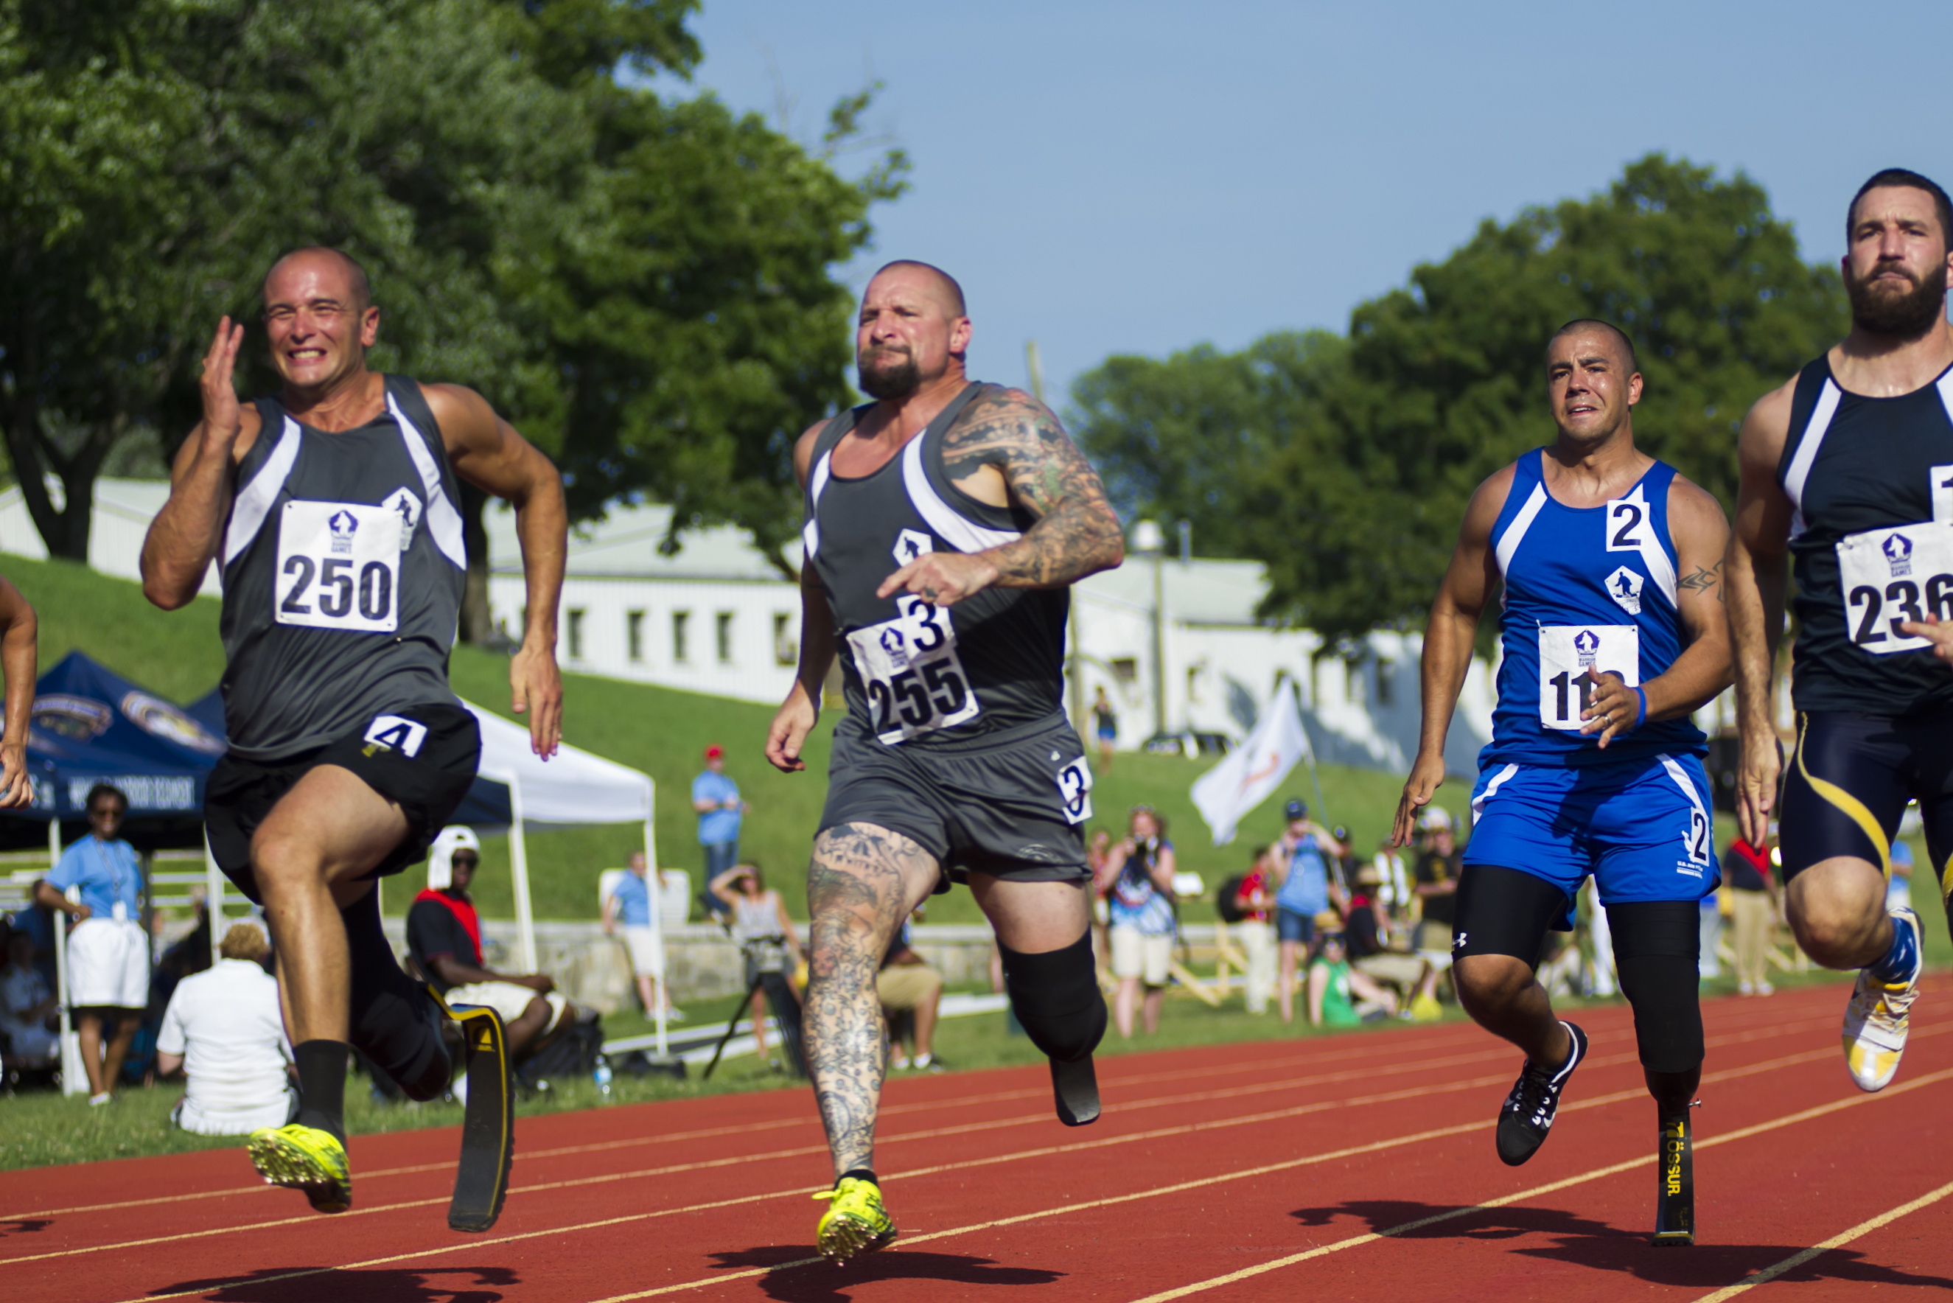
“Sprint” is an agile term for one period of an iterative cycle…
Notes:
Image Source: US Navy (US Government Works license)
https://www.flickr.com/photos/56594044@N06/18528338083/

Slide 33
But this metaphor wasn’t working for our Guides and Methods team.
Notes:
Image Source: US Navy (US Government Works license)
https://www.flickr.com/photos/56594044@N06/18528338083/

Slide 34
Metaphor table: iteration as sprint
Metaphor | Associations | Encourages… | Discourages…
iteration as sprint | running fast for a short period of time | speed feeling rushed burnout (it’s exhausting!) | focus on the final outcome sustainability

Slide 35
They found a metaphor that did the opposite — the organism to the machine.
Metaphor | Associations | Encourages… | Discourages…
iteration as sprint | running fast for a short period of time | speed feeling rushed burnout (it’s exhausting!) | focus on the final outcome sustainability

Slide 36
Metaphor table: iteration as constructing a building
Metaphor | Associations | Encourages… | Discourages…
iteration as sprint | running fast for a short period of time | speed feeling rushed burnout (it’s exhausting!) | focus on the final outcome sustainability
iteration as constructing a building | planned construction process | care and steadiness phased approach with dependencies | speed flexibility — once a foundation is laid, it is hard to change it

Slide 37
No one called the agile police.
Didn’t cost a dime.

Slide 38
3/ New metaphors are cheap!

Slide 39
How do you find a replacement?

Slide 40
Review what you have
REPLACING METAPHORS
Team ideas
Brainstorm together — go wild with sticky notes!
Brand assets
Team values or content guides can be great launchpads.
Meeting notes
What language and stories are people already using? (Caution!)

Slide 41
Instead of…
Try…
Pop culture
(movies, tv, books)
Even common references can leave people out and “other” them
Author/fandom may have unknown connotations
Shared memories or local touchstones
Places, spaces, events, stories the team experienced together
Doubles as a way to share the team’s history and culture over time

Slide 42
Change your perspective
REPLACING METAPHORS
Reverse engineer the table
Start from a different column. What do you want to encourage?
Draw or collage the situation
Stare at it. Squint at it. What comes to mind?
Leave your
desk
Literally change your perspective! Metaphors are everywhere.

Slide 43
To recap…

Slide 44
Metaphors translate concepts.
Metaphors reflect our values.
Metaphors shape our thinking.
Metaphors matter.

Slide 45
Metaphors are powerful and cheap.
Choose them carefully.
Question what they mean.
Experiment with multiple lenses. Replace them when they break.

Slide 46
Thanks!
Who we are:
Alex Bielen (18F Engineering Supervisor)
Laura Nash (18 Design Supervisor)
Contact alex.bielen@gsa.gov and laura.nash@gsa.gov

